Slide 1
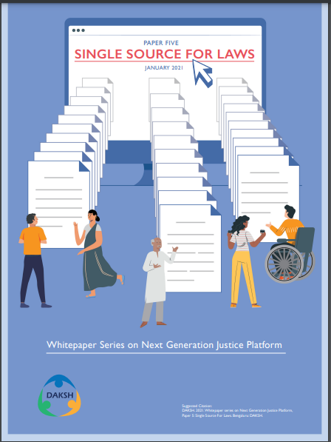
WHAT IS SINGLE SOURCE FOR LAWS AND WHAT ARE THE BENEFITS OF INITIATING A SINGLE SOURCE FOR LAWS
Single source for laws consolidates the various legislations across India, including state laws, central laws, ordinances, and amendments.
The purpose of an initiative such as the single source for laws is to enable all the stakeholders who are dependent on the laws to understand and interact with the laws that impact their life.
Digital solutions can be built on top of this single source for laws to improve access and comprehension. The single source can be a starting point to a long line of digital tools in the law and justice sector.

Slide 2

WHY EXPLORE THE POTENTIAL OF TECHNOLOGY AND LEGISLATION
The complexity in law-making, dissemination, and collation allows for technology tools to be leveraged.
These tools can allow streamlining for accessing legal information better.
Many such tools are being developed, piloted, and deployed currently at the international level.

Slide 3
Analysing and choosing the technology approach for India
Choosing and collating the laws - Picking a master legislation can be a useful start in terms of choosing a law to first collate and consolidate the laws at various levels. The related amendments and subordinate legislations to the master legislation like rules, notifications, circulars, etc., will be collated and sourced from the various departments and ministries.
Building for machine-readability - Once a master legislation is chosen and collated, there needs to be a process to make the same machine-readable. This would entail choosing a suitable methodology and technology application to make the consolidated legislations, including the master legislation and their amendments, machine-readable.
Presenting the consolidated legislation and identifying technology tools

Slide 4
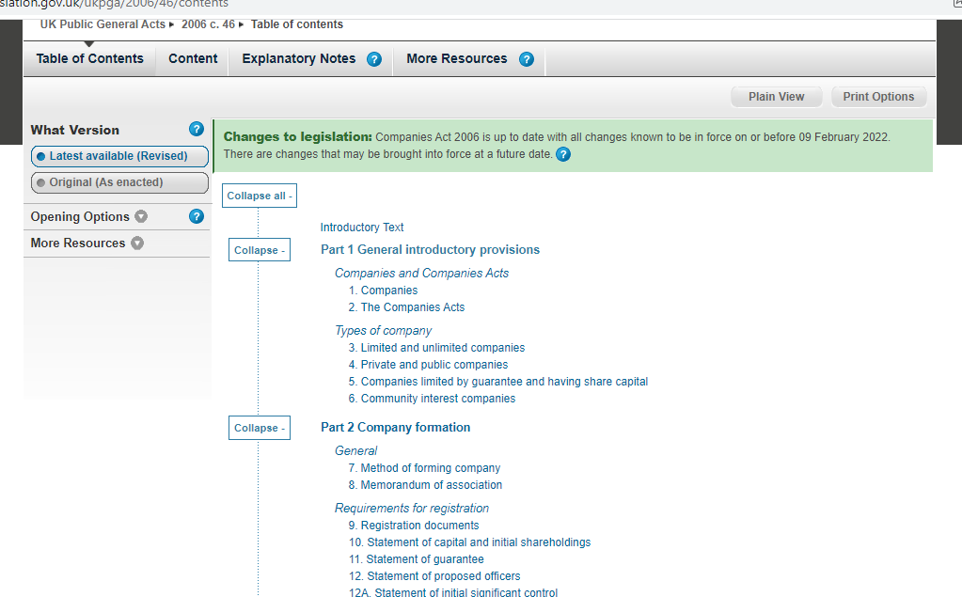

Slide 5
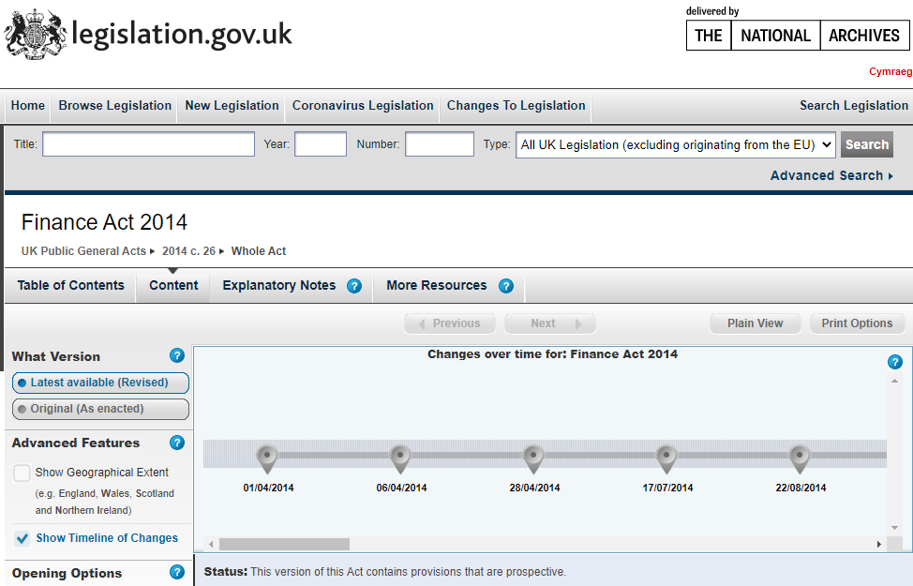

Slide 6
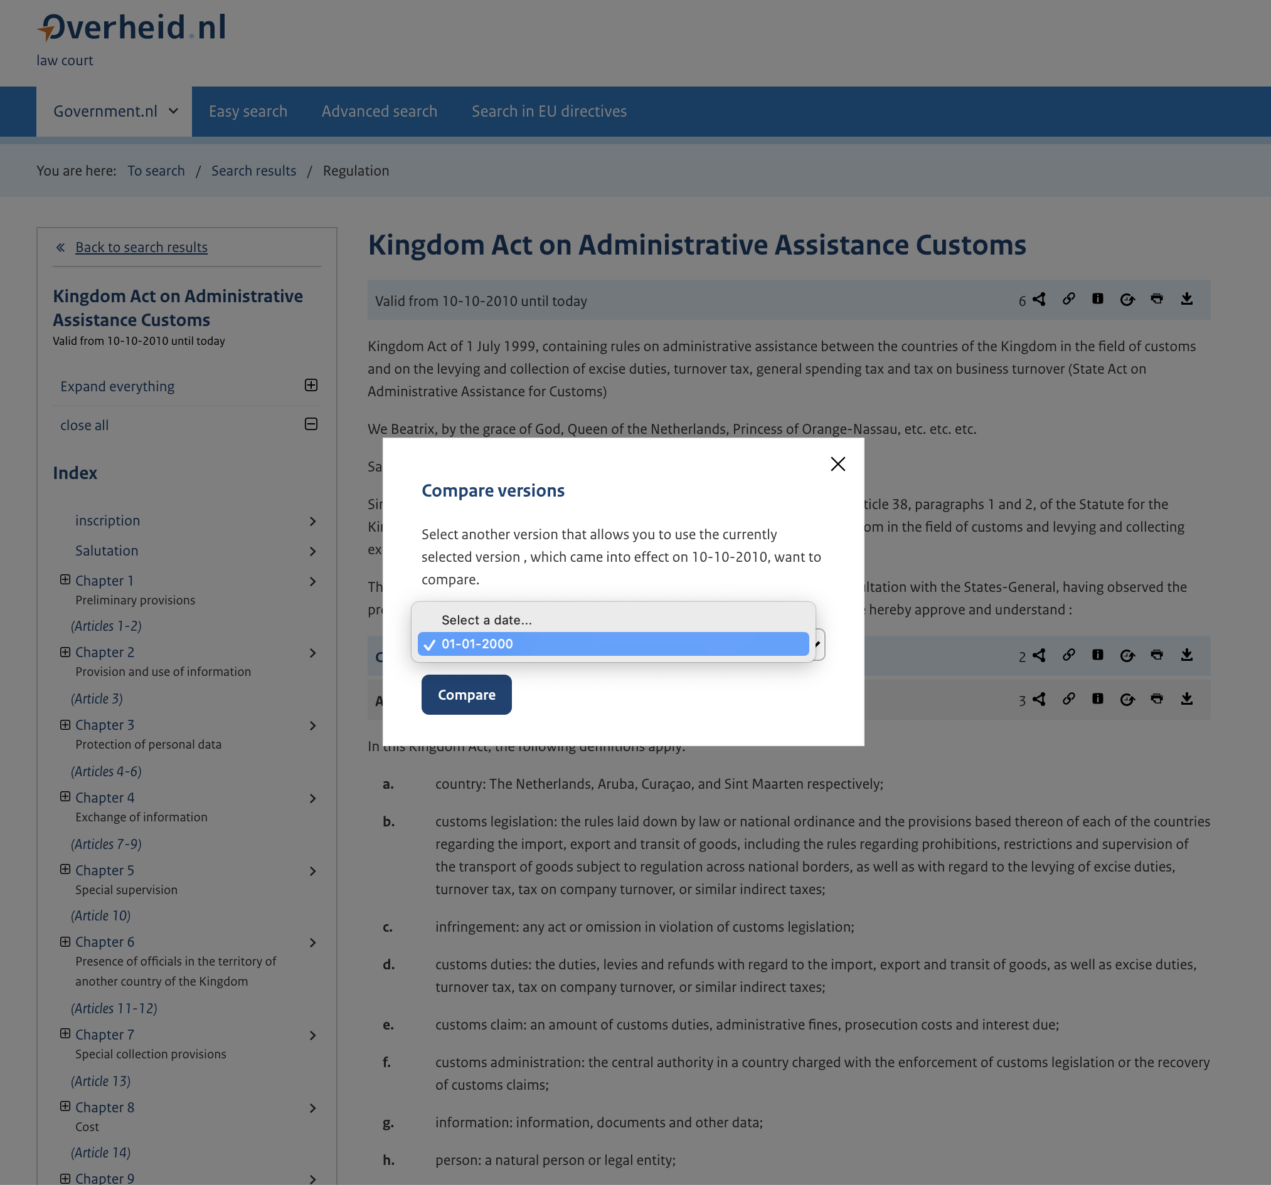

Slide 7
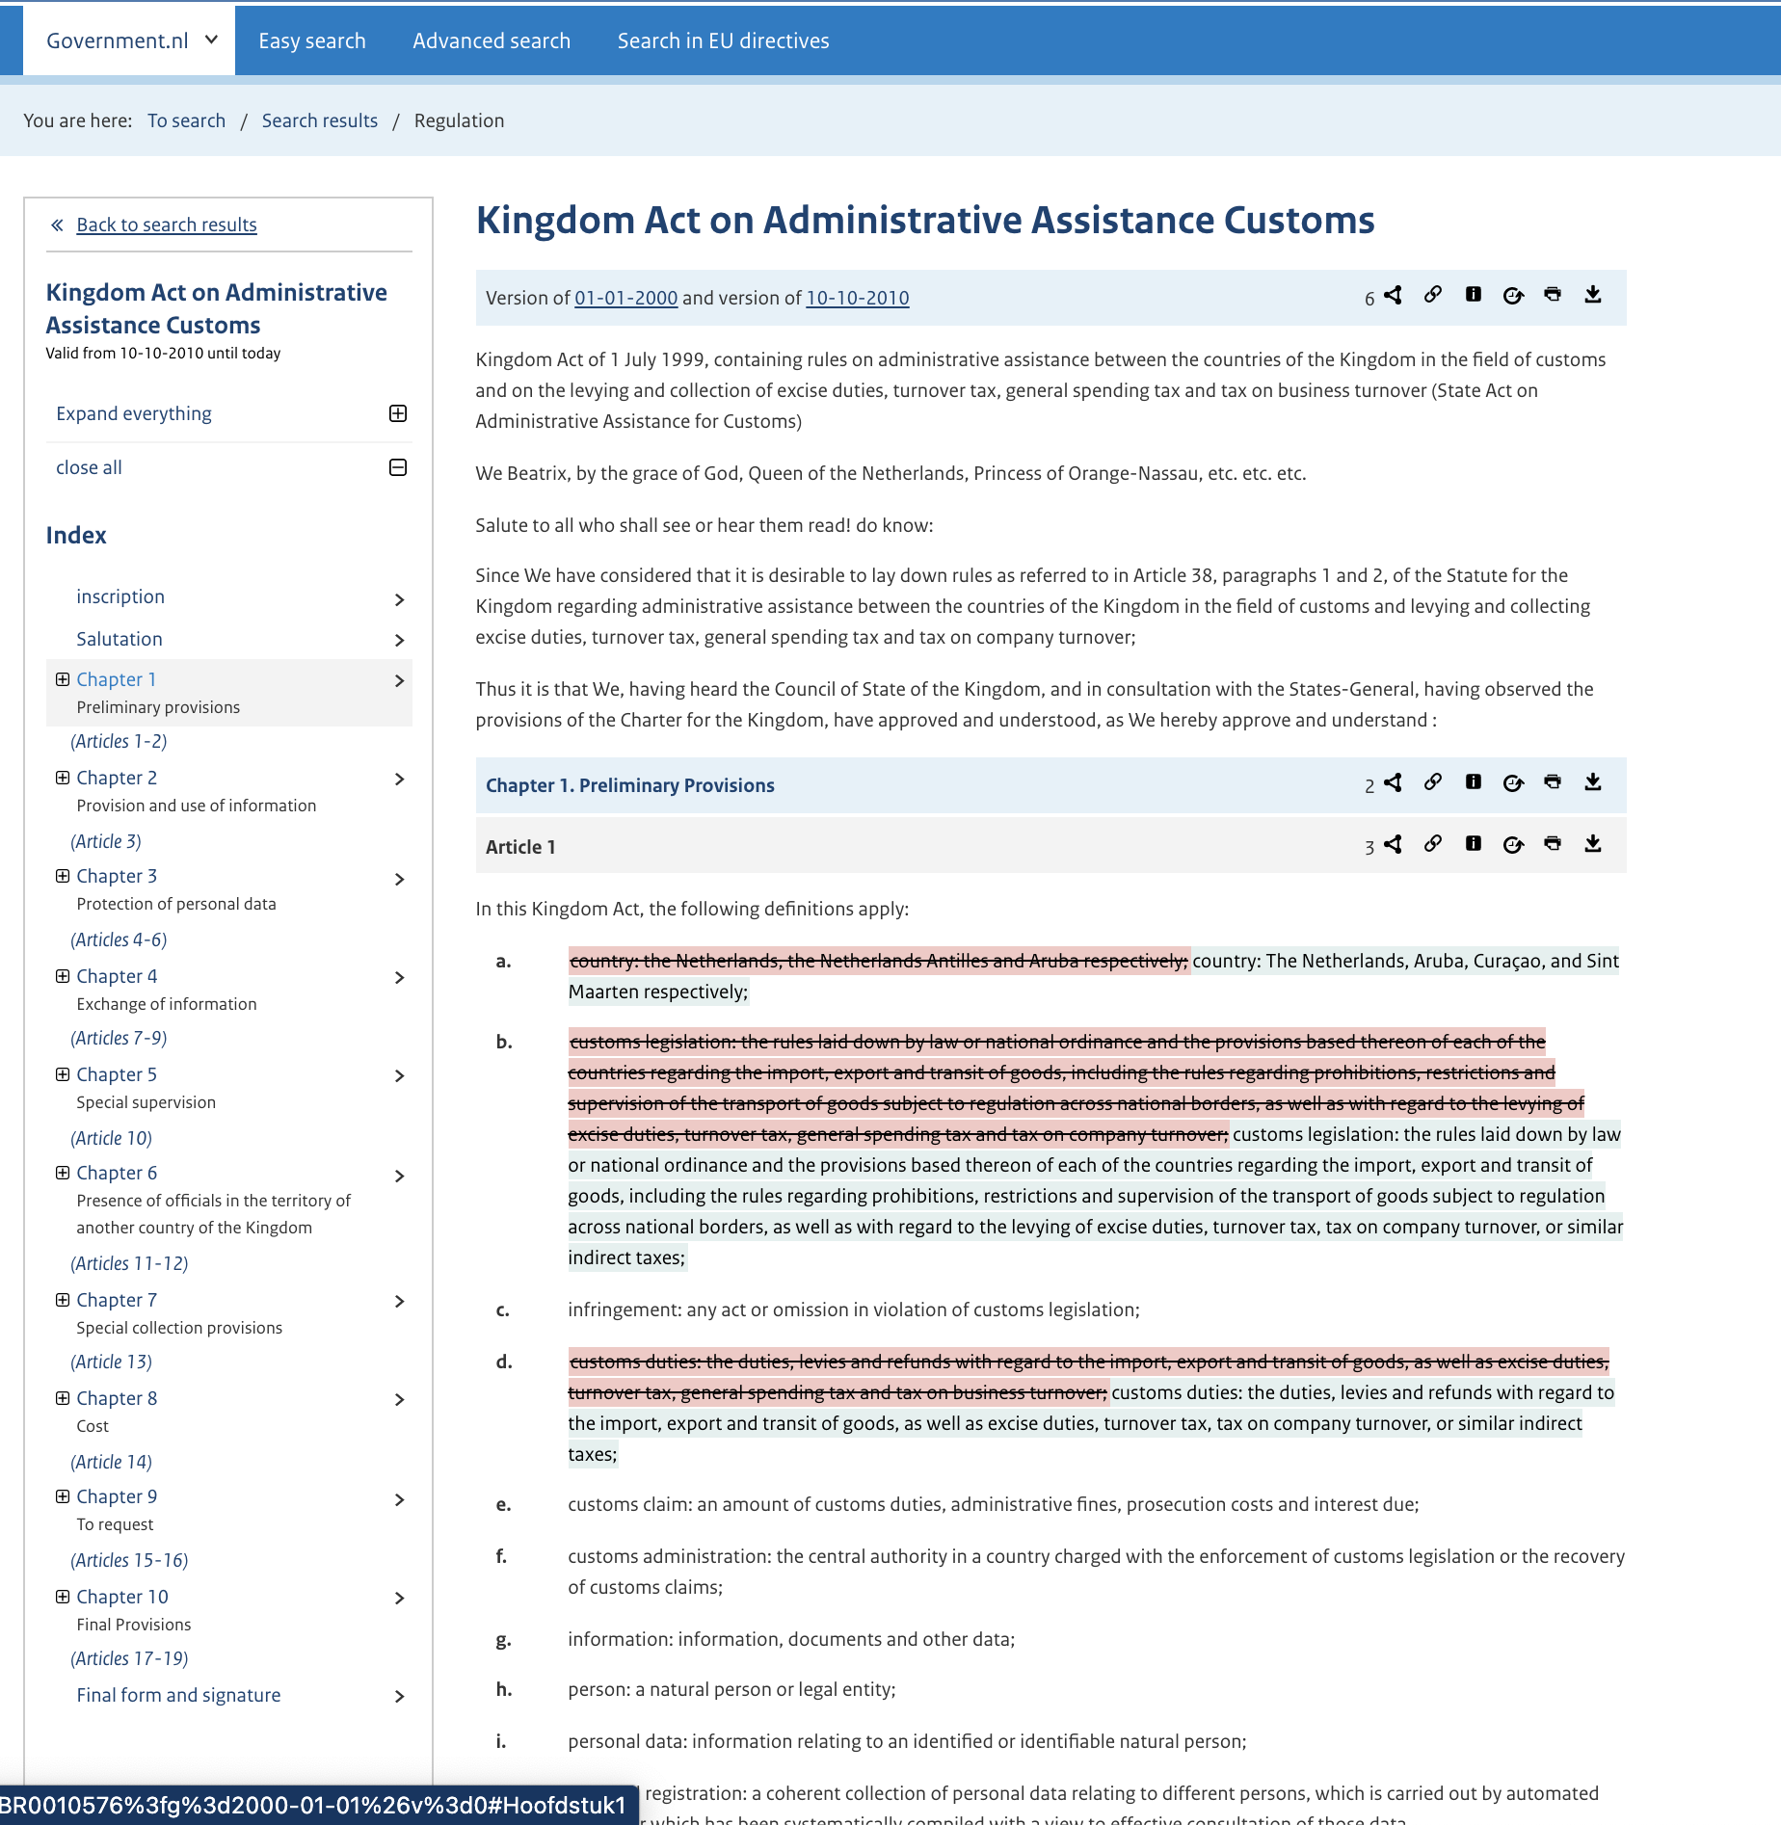

Slide 8

Discussion Points
Choosing a master legislation
Thinking about making the master legislation machine readable
Technology applications to apply – XML, JSON, or others?
Other approaches?

Slide 9
Case Study – DataLex http://austlii.community/wiki/DataLex
‘Rules as Code’ includes the activity of converting a legal text which is in a natural language (legislation, regulations, or other legal instruments – generically, ‘law’ or ‘rules’), into a representation in a computer-processable language (code). One application of this is that when processed by an appropriate program, this allows a human user to input data on a particular fact situation, and thereby produce conclusions which are an accurate statement of the legislative intent of the legal text when applied to that data.
Machine Learning has had limited success in relation to legal information. Legislative rules can be seen as being prescriptive, regulating social, business and economic activities. The temptation is to simply model these prescriptions, but this leads to an immediate conceptual fork between what legislative rules ‘say’ and what they are taken to ‘do’. The approach AustLII recommends is to avoid trying to represent what rules do, and instead to represent what they say.
The DataLex approach therefore involves the use of a less common approach to AI (symbolic representation), it aims to represent what rules say, not what they do, and it works within the constraint of assuming that resources available for AI developments will be limited.

